Slide 1
Crypto-Currencies Prediction
Birla Vishvakarma Mahavidyalaya
Information Technology
4IT31 : Project I
Guided by : Prof. Vishal Polara
Team members:
18IT401 – Smit Ghelani
18IT410 – Parth Panchani
18IT427 – Jigar Shekhat
19IT602 – Anuj Gajjar

Slide 2
What is Cryptocurrency ?
Crypto currency is a digital money or virtual money. That is money is not available physically and it is very secure.
In simple words we can say cryptocurrency is a money exchange process.
Most popular example for cryptocurrency is Bitcoin. It is the first ever introduced cryptocurrency.
Transactions done using cryptocurrencies are highly secure.

Slide 3

Aim of Our Project
In this Project, We analyse Crypto-currency market behaviour.
we are working with two algorithms Random forest and LSTM RNN and displaying their accuracy and prediction using graphical representation.

Slide 4
Project Module Implementation
Login
Data collection
Prediction – LSTM RNN
Data Visualization

Slide 5
Login :
Through this module, User can login in system.
Data Collection and Preprocessing :
We are collecting Cryptocurrency data from yfinance which owned by yahoo finance.
In this module we simply collect past 2 year data using yahoo finance. And using this data we separate out closed prices from that.

Slide 6
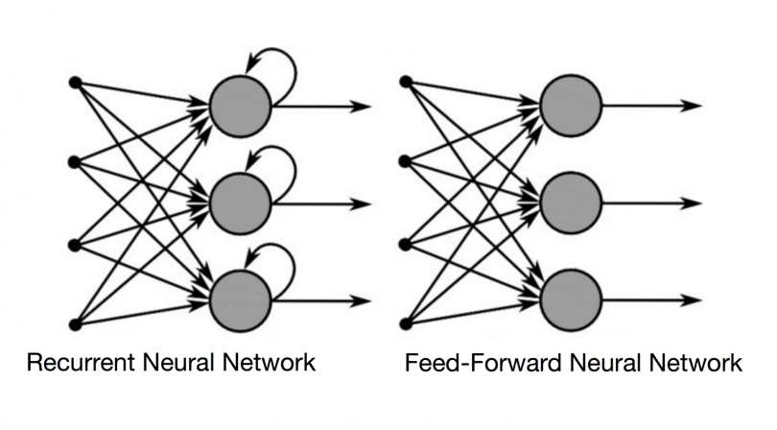
RNN
Recurrent neural networks (RNN) are a class of neural networks that are helpful in modeling sequence data.
Derived from feedforward networks, RNNs exhibit similar behavior to how human brains function.
Recurrent neural networks produce predictive results in sequential data that other algorithms can’t.

Slide 7
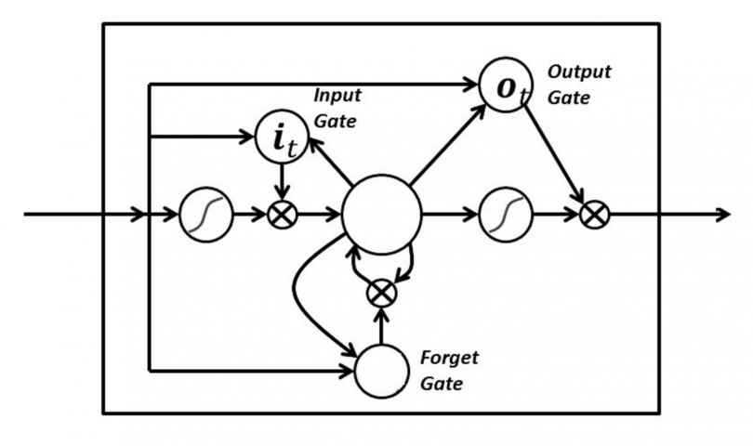
LSTM
Long Short-Term Memory (LSTM) networks are an extension of RNN that extend the memory.
LSTM are used as the building blocks for the layers of a RNN.
LSTMs assign data “weights” which helps RNNs to either let new information in, forget information or give it importance enough to impact the output.

Slide 8
How it works in project ?
Using collected data, We are manually splitting data into train and test set.
For LSTM-RNN, We are using sequential model to form recurrent neural network and we are adding three LSTM layer and one Dense layer combination.
Through User interface, User can select various optimizer like Adam, Adamax, Adadelta, Adagrad to get optimize result and also set number of training cycle for increase accuracy.
After using above data, we are training and predicting cryptocurrency prices.

Slide 9
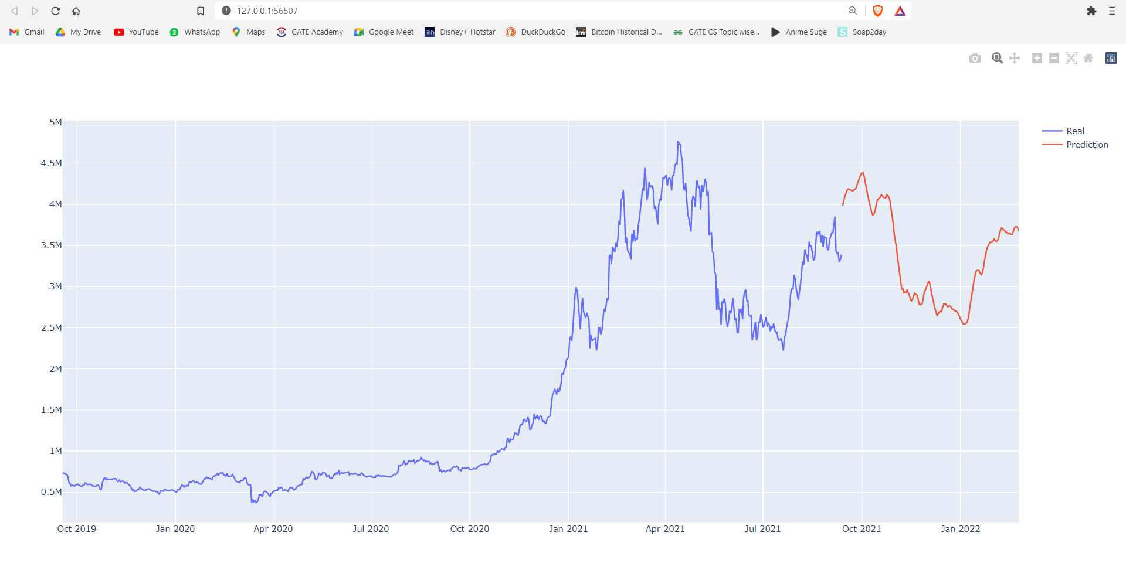
Data Visualization
This is basically sub module of cryptocurrency price prediction but we have separate it out for easiness. In this we get some data about cryptocurrency price prediction and display in form of table and graph so user can easily got the idea about future behavior of cryptocurrencies.
Also as a part of this module, we are displaying prediction results and collected past data values in form of normal and interactive graph.

Slide 10
Conclusion
Prediction accuracy of LSTM RNN is around 85-92% for adam optimizer which is better than others.
Selection of other parameter effect the accuracy of prediction model.
Remaining Work :
As we discussed before, we have chosen two algorithms. And we have completed one of them it is LSTM RNN but if time permits we will look back into it for improve the accuracy of that. So, second algorithm Random Forest algorithm is remaining and also its tuning part is remaining.

Slide 11

Thank you

